Slide 1
Deep Learning and Bitcoin Price Prediction
Deep Learning Systems - Spring 2022 - Columbia University
Griffin Klett
Nathan Cuevas

Slide 2
Motivation
BTC/Cryptocurrencies represent an incredibly interesting application problem to DL forecasting, involving unique technical factors (blocksize, chain activity, etc) and correlations with macroeconomic influences and of course public opinion
DL is uniquely suited to be applied because of the ability to capture and learn hidden/abstract patterns from such a varied data factor set, and the inherent structure which has been shown to involve long memory, and internal fractality that make traditional ML models less useful
Finally, the financial implications have made the area an active area of research, and many interesting papers have been published in the past few years on the subject as such

Slide 3
A Comparative Study of Bitcoin Price Prediction Using Deep Learning
Suhwan Ji, Jongmin Kim and Hyeonseung Im
Published: 25 September 2019
https://www.mdpi.com/2227-7390/7/10/898

Slide 4
Technical Contributions
Considers more complex DL models than previous studies
Considers both classification and regression performance while previous studies mostly consider only regression
Analysis on profitability of the models for algorithmic trading

Slide 5
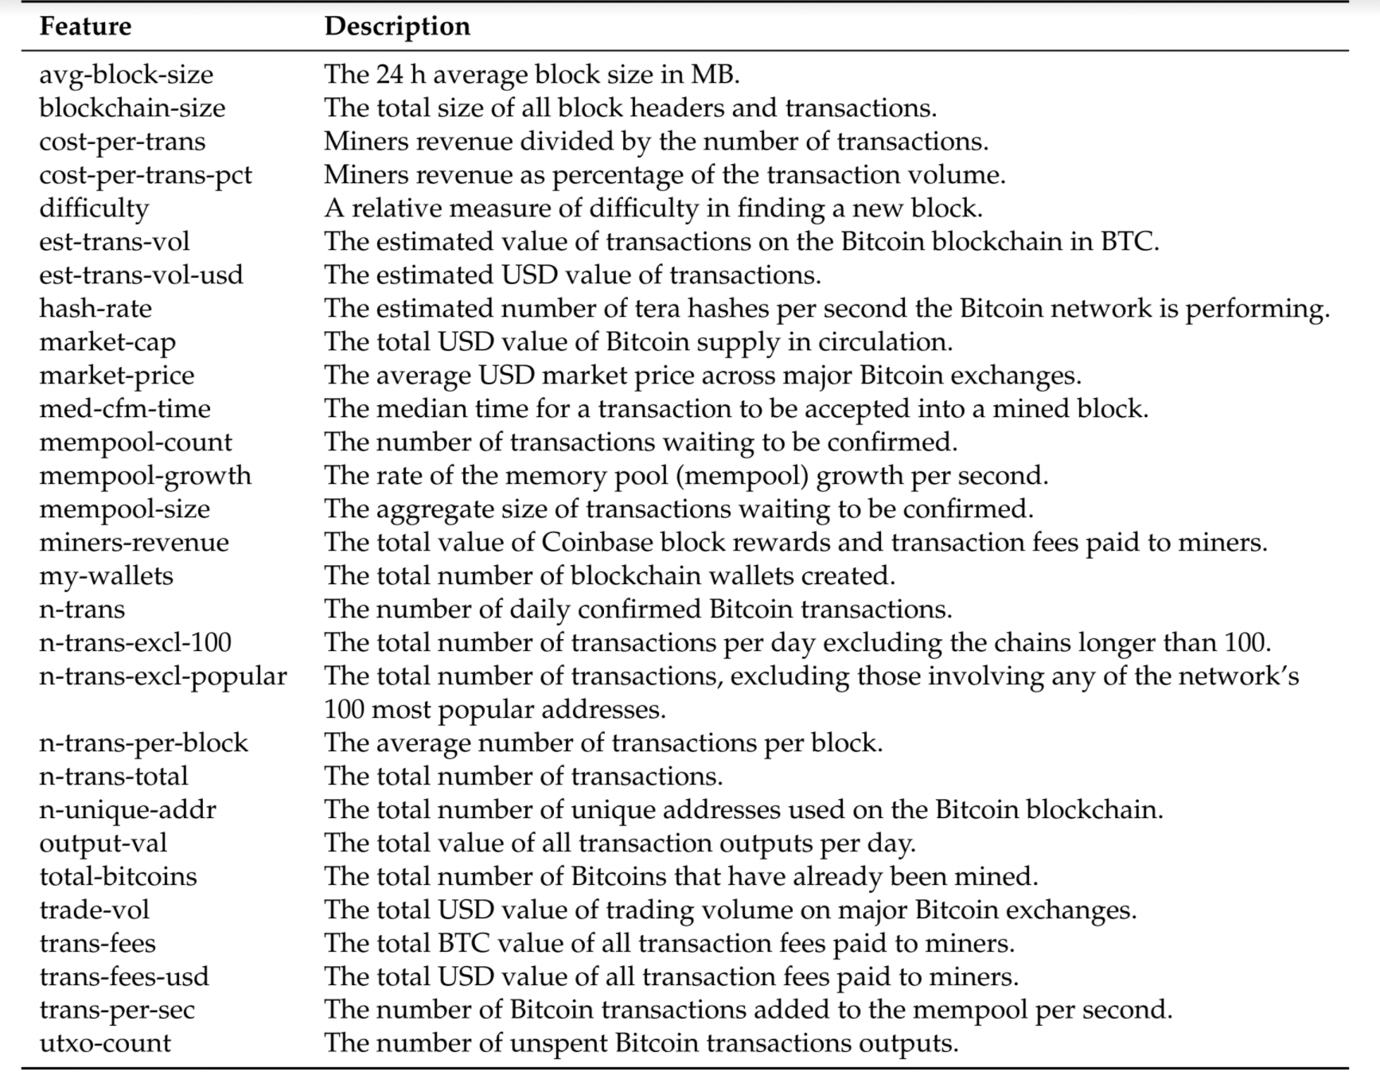
Data and Feature Engineering
Authors performed Spearman correlation analysis on the features
Excluded features that didn’t have a good correlation with BTC price
Only 18 of the most relevant features were kept

Slide 6
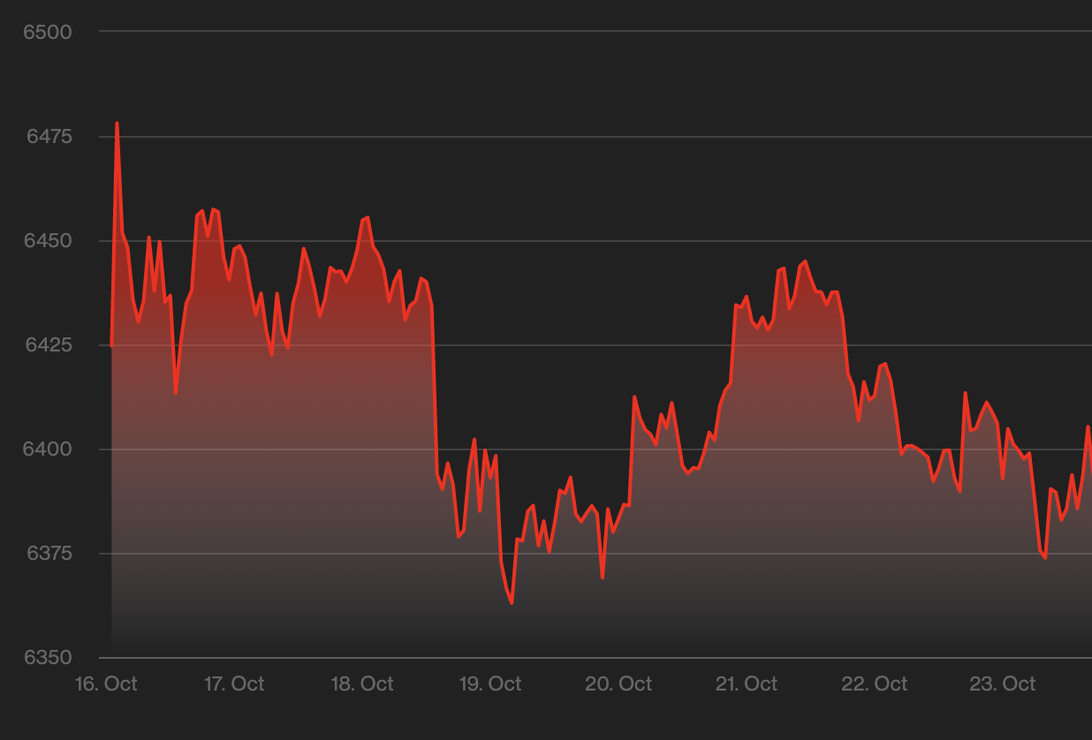
Data and Feature Engineering
m = 5
2590 days of BTC data
Made prediction for next day based on m days of previous data
Classification model aims to predict whether price should go up or down
Regression model aims to predict the price

Slide 7
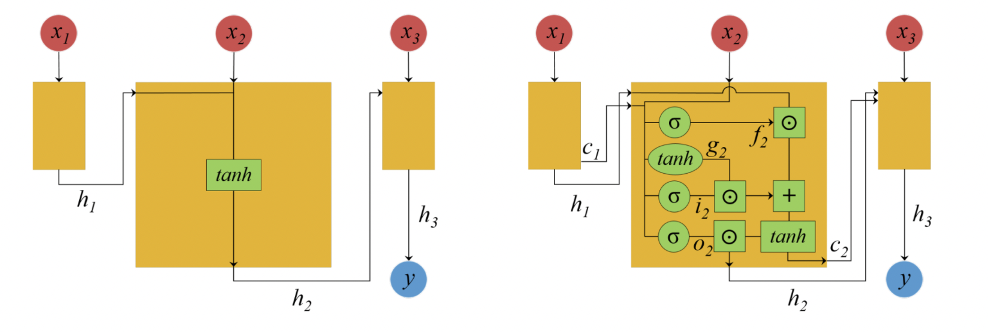
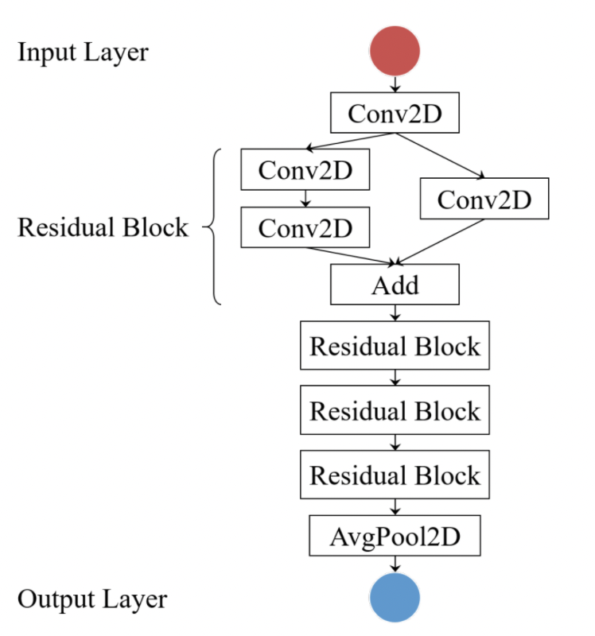
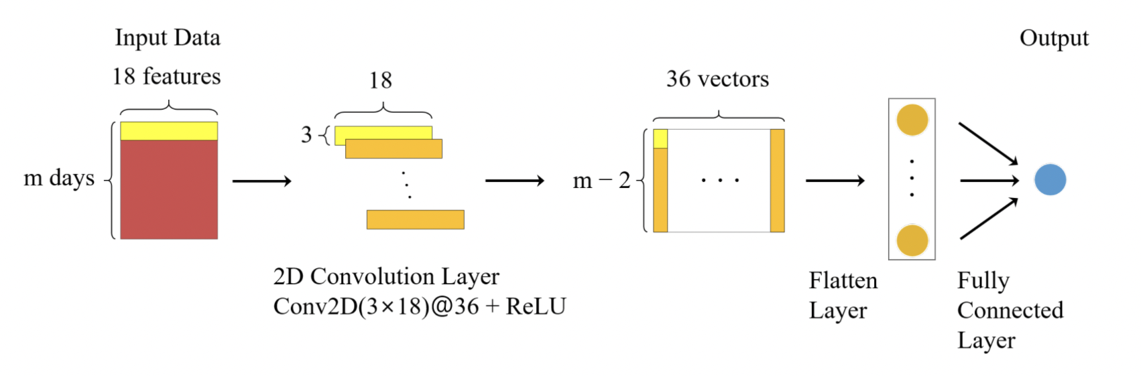
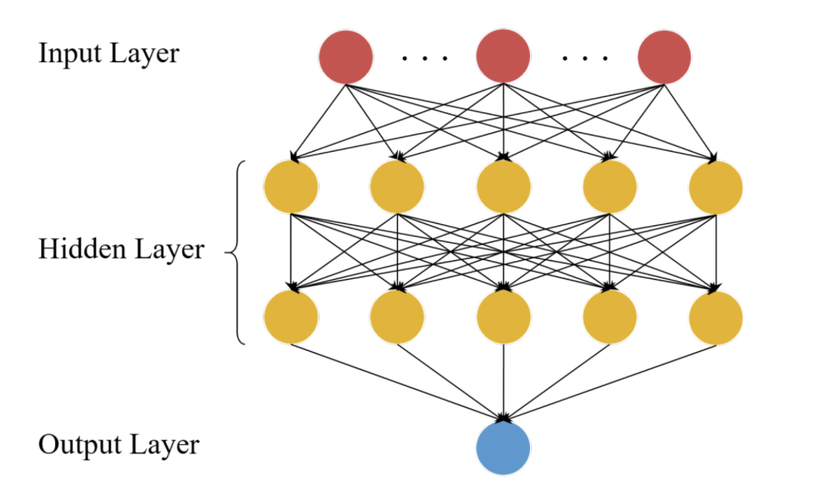
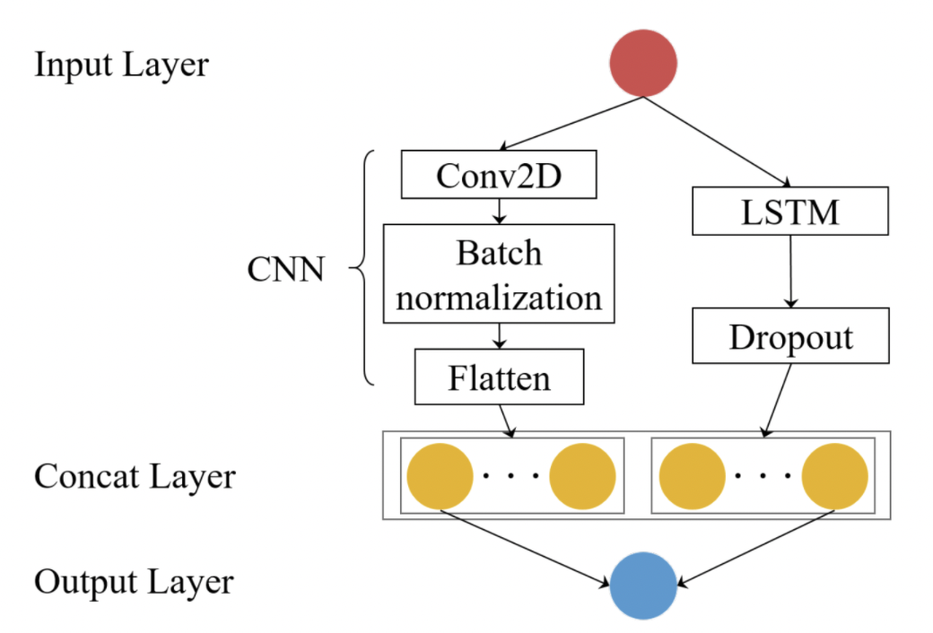
Models
Recurrent Neural Network (RNN)
Long Short Term Memory (LSTM)
Deep Residual Networks (ResNet)
Deep Neural Network (DNN)
Convolutional Neural Networks (CNN)
CNN + RNN -> CRNN

Slide 8
Model Performance
Regression models performed the best with low m
regression models behave more like a shift model
not good at predicting during peaks and valley periods
LSTM was only slightly the best model
Classification models performed the best with high m
DNN was only slightly the best model
ResNet didn’t perform well
likely due to not enough data (ResNet has a lot of layers)
None of the models exceeded 60% in accuracy

Slide 9
Profitability Performance
Models
was given $10,000
was given some investment period (paper uses 9/20/2017 -> 12/31/2018
sold when price was predicted to go down, bought when the price was predicted to go up
All regression models lost money
All classification models except for SVM made money
best model was DNN and had a total of $10,878 by the end of the simulation
Still not a viable model for algorithmic trading
the random model made $9919

Slide 10
Deep Learning Methods for Modeling Bitcoin Price
Prosper Lamothe-Fernández, David Alaminos, Prosper Lamothe-López and Manuel A. Fernández-Gámez
Published: 30 July 2020
https://www.mdpi.com/2227-7390/7/10/898

Slide 11
Technical Contributions
Model achieves very high accuracy w/r/t to previous literature, achieving ~95% accuracy while Ji et. al only achieved ~55% accuracy
Identifies significant variables that were not significant or were not used in previous literature

Slide 12
Models
Deep Recurrent Convolutional Neural Network (DRCNN)
hybrid of convolutional neural networks and recurrent neural network
Deep Neural Decision Trees (DNDT)
neural networks where the weights correspond to a decision tree
Deep Learning Linear Support Vector Machines (DSVR)

Slide 13
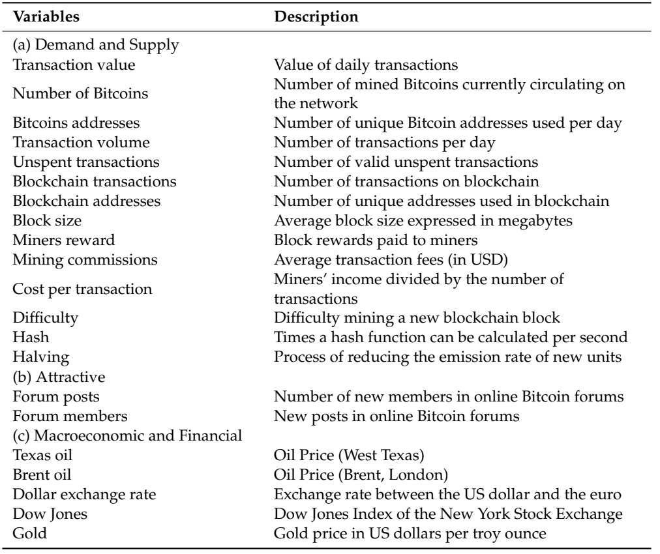
Variables and Sensitivity Analysis
Data sampled from 2011-2019
supply and demand variables, attractiveness, macroeconomic and financial variables,
Sobol sensitivity analysis will help determine most relevant variables

Slide 14
Results
In terms of performance DRCNN (~95%) > DNDT (~94%) > DSVR (~93%)
Much better than previous literature
Sobol analysis determined that the most significant variables (across all 3 of the models) are block size, cost per transaction and difficulty
In DRCNN, additional significant variables include the transaction value/volume, block size, dollar exchange rate, Dow Jones, and gold

Slide 15
Cryptocurrency forecasting with deep learning chaotic neural networks
Salim Lahmiri, Stelios Bekiros
Published: January 2019
Full paper: https://www.sciencedirect.com/science/article/pii/S0960077918310233

Slide 16
Technical Contributions
Investigation of structure of time series of digital currencies revealed fractal dynamics, long memory, and self-similarity
Validation via comparison of LSTM vis-a-vis GRNNs which failed to approximate global non-linear patterns [paper discusses how GRNNs based on Gaussian kernels are suitable only for local approximation of non-stationary signals]
Dataset relied solely on daily prices in US dollars for BTC from 2010-2018 [two other digital currencies were also tested, the scope of which is beyond our paper, but confirm similar results]

Slide 17
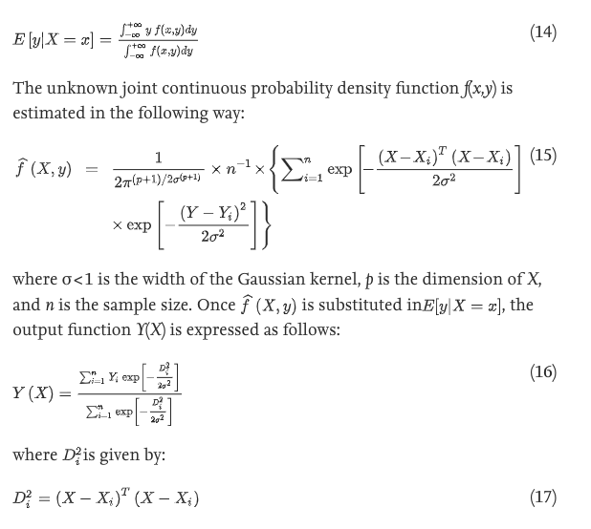
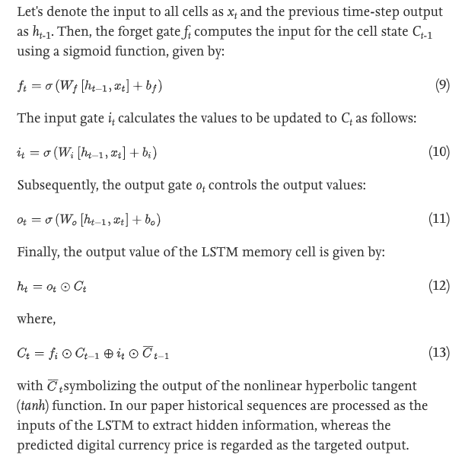
Models
Baseline GRNN uses gaussian kernel and four layers: input, pattern, summation, and output layer, with input as past price and output as future price
Standard LSTM used to take advantage of Long Memory features in pricing using input gate, forget gate, and output gate

Slide 18
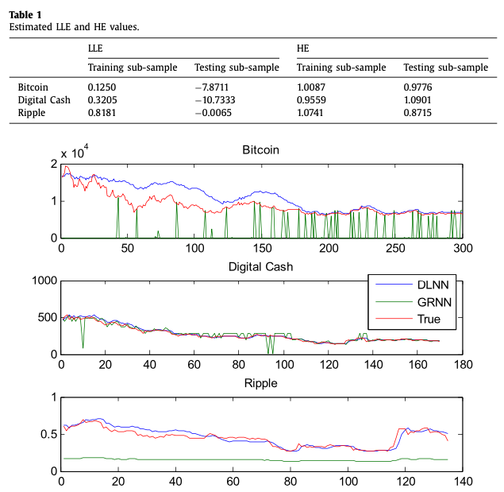
Results
Blue line represents DL predictions - massive improvement upon general regression NN - measured via RSMEs
DFA and LLE analysis showed evidence in form of fractality which shows evidence of short term predictability
LSTM model was able to learn chaotic and self-similar patterns - confirming effectiveness to forecast digital currency markets
Calculated HE value showed long memory-features, inherent fractality

Slide 19
Forecasting the price of Bitcoin using deep learning
Mingxi Liu, Guowen Li, Jianping Li, Xiaoqian Zhu, Yinhong Yao
Published: May 2021
Full paper: https://www.sciencedirect.com/science/article/pii/S1544612320304864?via%3Dihub

Slide 20
Technical Contributions
Improved upon previous studies to create determinants of Bitcoin price based upon (broadly) (1) cryptocurrency market factors, (2) macroeconomic environment, and (3) public attention
Application of DL method named Stacked Denoising Autoencoders (SDAE) to predict next day prices
Vis-a-vis comparison with benchmark methods Support Vector Regression (SVR) and Back Propagation Neural Network (BPNN) which are widely used as the best performing ML methods for forecasting domain
Validation of DL as an effective tool for forecasting BTC price as it can learn from sophisticated features by abstracting multiple levels of representation

Slide 21
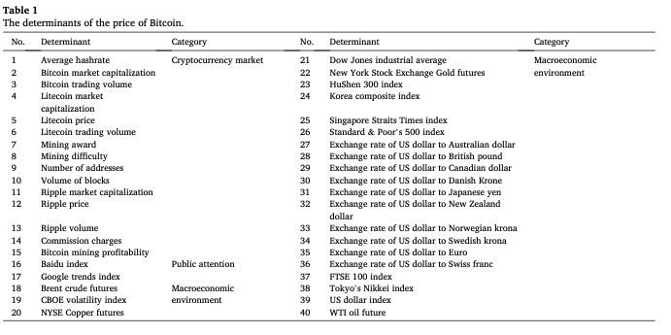
Data and Feature Engineering
Time period of these data span from July 2013 to December 2019, normalized to [0,1]
80-20 test train split

Slide 22
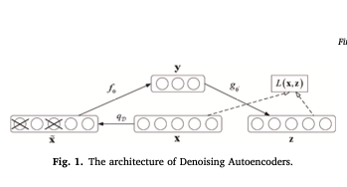
Models
SDAE network structure set to [40, 40, 20, 1], with activation functions of encoder as sigmoid, and decoder as linear function,
Learning rate of 0.1, batch size of 50, number of epochs is 20
We have requested the github/code from the paper’s authors via email, hope to be able to replicate results
Comparison/benchmark BPNN is one hidden layer with network structure of [40, 20,1] and sigmoid activation function, learning rate 0.1
MSE loss function for SDAE/BPNN
Other benchmark models SVR and PCA-SVR a Gaussian kernel is employed and Grid search + 5-fold validation are used to optimize.

Slide 23
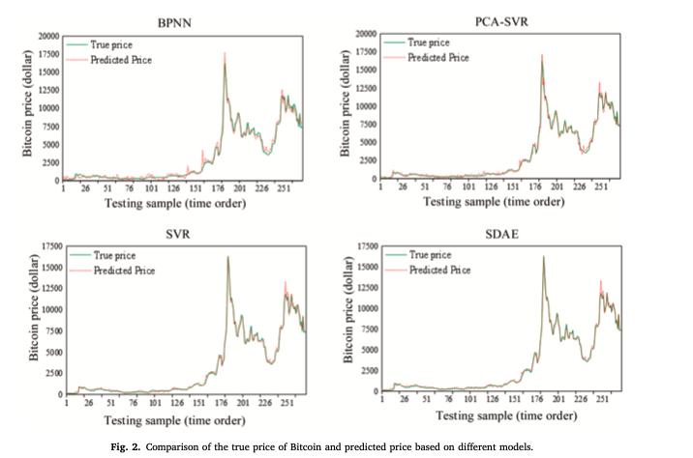
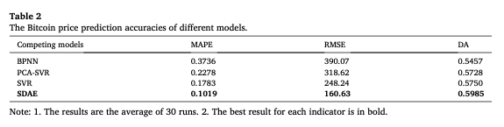
Results
SDAE lowest MSE, BPNN performs worst during periods of wild fluctuations
SVR is competitive in terms of accuracy but requires more computational costs and time intensity to learn params

Slide 24
Observations / Insights
General consensus is that the timeseries structure of the data lends itself well to forecasting using DL, specifically those that can capture abstract patterns at higher levels and understand long term memory, fractality
Quite a bit of research has been done on the determinants of BTC/cryptocurrency pricing, many of the papers we examined either referenced previous work directly or expanded. Other papers focused solely on price data as input to determine inherent structure
Papers that introduced new DL techniques to BTC forecasting (SDAE & LSTM) only compared against baseline models, and further exploration necessary to understand the actual profitability of these approaches

Slide 25
Conclusion
Ji et. al (our first paper) did use actual backtesting and measure comparative profitability, but found limited success with the existing models, but was relatively older (published 2019)
Further analysis could be done to apply similar comparative pricing/profitability backtesting to models that showed success in recent years such as SDAE, which perhaps our project could examine more closely and contribute to the literature in this way, as well as using a more updated determinant of factors on some of the models Ji et. al used
Finally, we hope through correspondence with the paper’s authors to be able to get a better glimpse into the training/structure of the models described in the papers, which would allow us to do interesting followup experiments and better understand the actual implementation

